Slide 1
HomeSnitch: Behavior Transparency and Control for Smart Home IoT Devices
CS 5153/6053 Network Security Final Project
By: Adam Jarvis &
Ryan Logsdon

Slide 2
Technical Problem Addressed
Motivating Example (Alexa API Abuse):
Use Alexa API to create a simple application to solve math problems
Provide a null value to a prompt
Record audio indefinitely with the user believing the device is no longer listening
Problem Statement
Design a system to provide the primitives for transparency and control behaviours of otherwise resource constrained smart home IoT devices.
There are a lack of institutional guidelines surrounding the software and network security of smart-home devices
Compromised or misbehaving devices may attack other network hosts or eavesdrop
Challenge: Define which behaviors are acceptable and which behaviors are unacceptable while upholding the security of encrypted payloads
HomeSnitch was created to provide a means of defining the semantic behavior of an IoT device and enact policies to provide access control and transparency

Slide 3
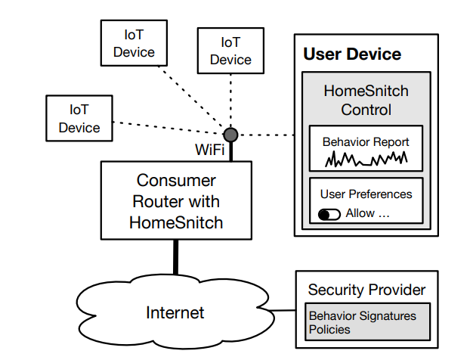
System Model
System Model:
HomeSnitch is designed for residential home networks with various IoT devices
Assumptions:
Devices contain default credentials
Devices lack sufficient security protocols
Devices enable over-privilege
Devices contain un-patched vulnerabilities
All devices are connected (wired or wirelessly) to a consumer-grade router
HomeSnitch is attached to this router:
Program runs on a Raspberry Pi 3 Model B
Attached via Ethernet
HomeSnitch uses IP connection-oriented protocols to prevent such attacks

Slide 4
Threat Model
Adversary Goal:
Exploit devices to cause physical effects such as turning off an alarm
Steal data
Enable remote surveillance
Steal credentials
Compromise other network devices
Strategy:
Launch an attack, or abuse server-side privileges on the service-provider of a device
Traditional security approaches involve:
Scanning for vulnerabilities
Enabling fine-grained permissions on the host
Patching vulnerabilities
A smart home network of devices cannot employ any of these approaches as a defense
A threat can compromise a device through:
Nat hole punching
Lateral pivoting from other compromised devices
Gaining physical control of the device
Abusing cloud-based control

Slide 5
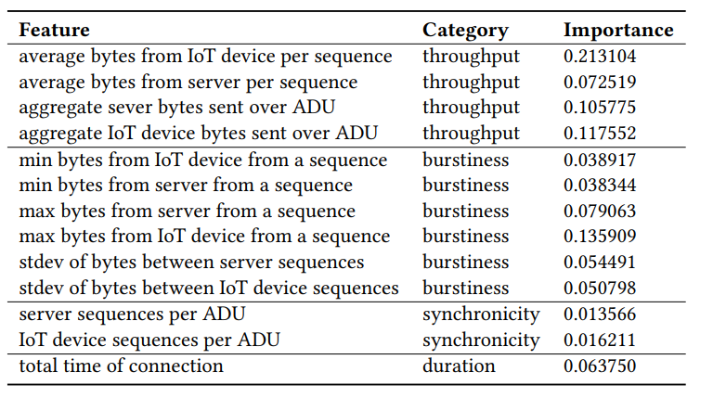
Current Solution
HomeSnitch is broken down into 3 key steps:
Monitor network flows to determine devices that are communicating with the network
Classify each communication exchange as a semantic behavior.
Process these behaviors through a policy algorithm to determine if the exchange should be allowed or denied
Machine learning algorithm was used to classify network flows and identify new behaviors.
Random Forest algorithm for classification
DBSCAN to supply training data sets
Monitor Network Flows:
Adudump is utilized for continuous measurement of application-level data from network flows.
“Adudump uses TCP/IP packet header traces to construct a model […] encryption at the application layer was no longer a barrier.”

Slide 6
Current Solution Continued
Semantic Behaviors
Semantic behaviors are classified using the Random Forest algorithm
Leverages both ensemble and averaging methods to build several estimators independently and then average their predictions
Based on the monitoring of network flows, each statistic is calculated into a single application data unit.
Smart home devices are predominantly sequential with the server and client taking turns
There is a large semantic gap between the bytes sent in packets and the behaviors that are understandable by users
Behaviors such as heartbeat, firmware check, motion detection, etc. are classified as a semantic triple:
<vendor>, <model>, <activity>
Ring, Doorbell, Motion-Upload
Some of these behaviors are more frequent than others, such as a device heartbeat
HomeSnitch must provide a means of identifying when a “non-normal” activity is allowed or not allowed
Is it a new device that has come online?
Is this device malicious?
Is it a current device doing a less frequent task?
Is this task malicious?

Slide 7
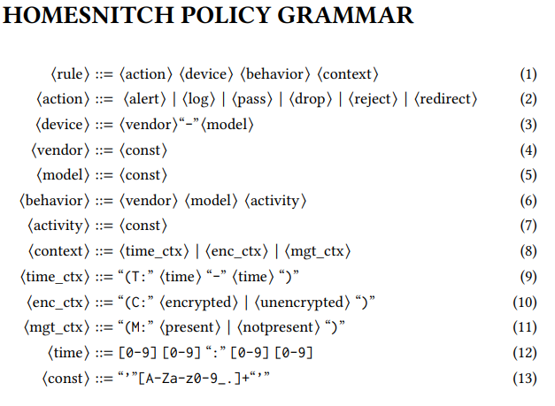

Current Solution
Policies
HomeSnitch uses a Device, Behavior, Context → Action model to express access control policies
Device behavior that has been classified as normal, such as a Ring Doorbell uploading a small motion detection, will be permitted by the policy.
Unusual action, will be denied, such as a smart lock being opened when the management device is not on the network

Slide 8

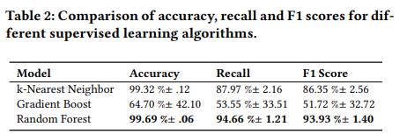
Experimental Results
Experiments of the HomeSnitch solution were based around testing accuracy of classification, performance impact on throughput, and amount of training needed to classify new behaviors.
The experiment was conducted on a network consisting of 46 devices registering 148 semantic behaviors on over 2,000 connections to cloud endpoints.
Throughput saw an increase of ~100ms:
To evaluate the amount of training required by the solution, a test-training set approach iterated through 200 samples of behavior classes. A prediction score was calculated for the remaining unlabeled samples from the behavior class.
90% Prediction Confidence Required 58 samples
95% Prediction Confidence Required 63 samples

Slide 9
Evaluation
HomeSnitch solution was able to derive a system capable of semantically categorizing IoT device behavior in a residential environment.
Through testing against malicious behavior, the system was able to offer insight to a user that a device was compromised via a malicious attack.
The context free grammar utilized for policy creation was able to effectively regulate access control across numerous devices.
It was determined that the few inconsistencies witnessed during the experiment were during heartbeat activities of IoT devices.
Heartbeat activities account for a vast majority of device activity, while also presenting the smallest threat to attack.
The HomeSnitch solution appears to provide a thorough defence mechanism against the network security pitfalls present within smart-home devices.

Slide 10
Limitations
Mimicry Attacks
Supervised machine learning leverages classifiers to identify traffic patterns that represent device behaviors
An informed adversary that is able to compromise a device and mimic the traffic patterns of permitted behaviors would be able to bypass the classification system.
In order to successfully overcome the policy rules, an attacker must learn the contents of the content grammar.
Complementary approaches including device identity, anti tampering and device attestation are potential solutions to this limitation.
Partial Flow Analysis
Another limitation of this device is the requirement of capturing the full network flow for precise classification
To enable real-time enforcement, historical flow data must be considered to modify instructions.
Given the simplistic communication methods of these IoT devices, a modified approach would be feasible to predict realtime behaviors without increasing latency.
The authors propose the construction of a stochastic model as a topic for future research around this limitation.

Slide 11
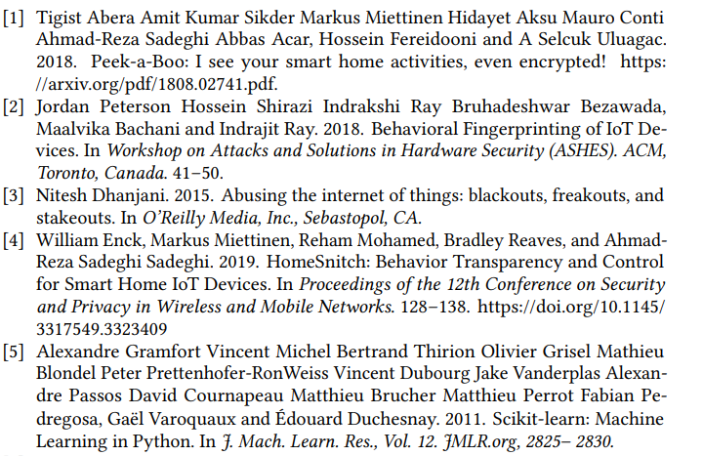
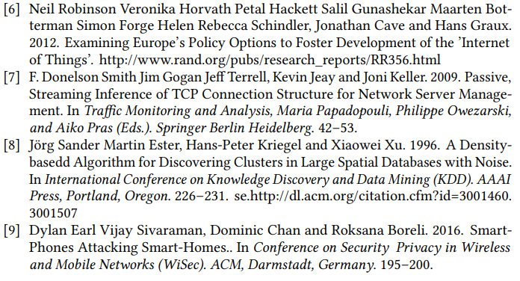
References

